Slide 1

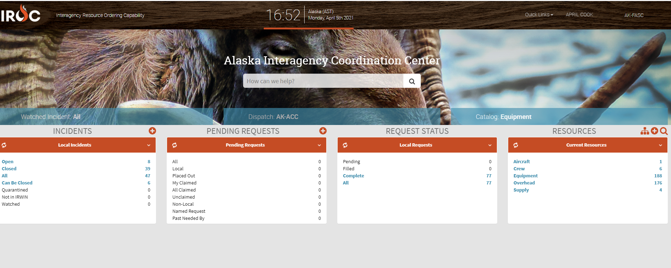
GETTING ACQUAINTED WITH IROC
Unit 3
D-110 Unit 3: Getting Acquainted with IROC
D-110 Unit 3: Getting Acquainted with IROC

Slide 2
Objectives
Describe the electronic resource tracking system
Identify and navigate the main IROC Home screen
Demonstrate the functionality of personal settings
Identify the following IROC screens and functions:
New Request, Resource Status, Pending Request, Request Status, and Documentation
Describe unit ID components and dispatch channels as they relate to IROC.
D-110 Unit 3: Getting Acquainted with IROC
03-1-D110-EP

Slide 3
What is IROC?
The National Interagency Resource Ordering Capability is utilized in an estimated 300 interagency dispatch and coordination centers throughout the nation.
IROC tracks all tactical, logistical, service and support resources mobilized by the incident dispatch community.
D-110 Unit 3: Getting Acquainted with IROC
03-2-D110-EP

Slide 4
IROC Security
Accessible to anyone with internet
ONLY work under YOUR username account
IROC session will "time out" after thirty minutes. Any unsaved work will be lost!
D-110 Unit 3: Getting Acquainted with IROC
03-3-D110-EP

Slide 5
Dispatcher Roles
Dispatcher: Access IROC home screen, reports, and help.
Dispatch manager : Ability to use advanced search functions and modify data
IMT Roster Manager: For team members to modify Rosters
IMT Ordering Manager: For Ordering Managers access
Selection Area Manager To create selection areas for direct ordering authority (Most likely EDRCs will not be Selection Area Managers)
D-110 Unit 3: Getting Acquainted with IROC
03-4-D110-EP

Slide 6
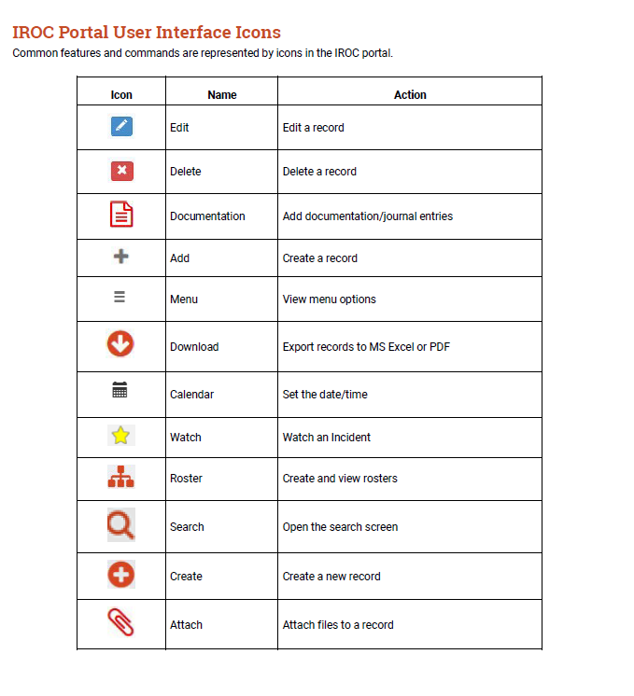
IROC Icons
D-110 Unit 3: Getting Acquainted with IROC
03-05-D110-EP

Slide 7
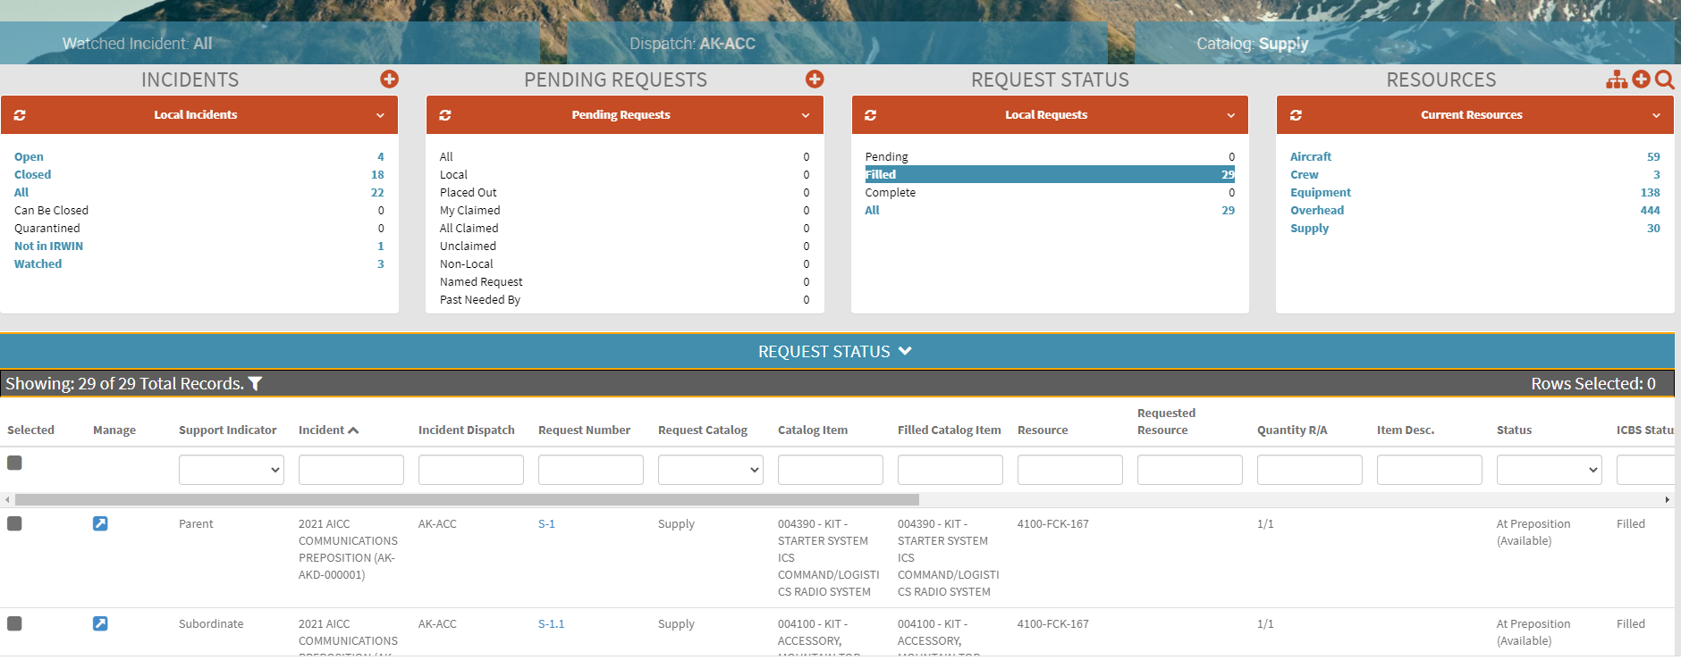
Content Selectors, Action Tiles and Main Work Area
D-110 Unit 3: Getting Acquainted with IROC
03-6-D110-EP

Slide 8
Objectives
Describe the electronic resource tracking system
Identify and navigate the main IROC Home screen
Demonstrate the functionality of personal settings
Identify the following IROC screens and functions:
New Request, Resource Status, Pending Request, Request Status, and Documentation
Describe unit ID components and dispatch channels as they relate to IROC.
D-110 Unit 3: Getting Acquainted with IROC
03-7-D110-EP

